Slide 1
Introduction
Conti…

Slide 2
Overview
Different Types of Network Devices
Different Types of Network Delay

Slide 3
Network Devices
Hub
Repeater
Bridge
Switch
Router
Gateways
Brouter

Slide 4
Hub
A hub is basically a multiport repeater.
A hub connects multiple wires coming from different branches
Hubs cannot filter data, so data packets are sent to all connected devices.
They do not have the intelligence to find out best path.
Notes:
A hub connects multiple wires coming from different branches, for example, the connector in star topology which connects different stations.\
They do not have the intelligence to find out best path. for data packets which leads to inefficiencies and wastage.

Slide 5
Repeater
operates at the physical layer.
Its job is to regenerate the signal .
It is a 2 port device.
Notes:
A bridge is a repeater, with add on the functionality of filtering content by reading the MAC addresses of source and destination.
An important point to be noted about repeaters is that they do not amplify the signal.
When the signal becomes weak, they copy the signal bit by bit and regenerate it at the original strength.

Slide 6
Bridge
A bridge operates at data link layer.
A bridge is a repeater. with add on the functionality of filtering content.
It is also used for interconnecting two LANs working on the same protocol.
It has a single input and single output port, thus making it a 2 port device.
Notes:
A bridge is a repeater, with add on the functionality of filtering content by reading the MAC addresses of source and destination.

Slide 7
Switch
A switch is a multiport bridge with a buffer.
A switch is a data link layer device.
The switch can perform error checking before forwarding data.
Notes:
A switch is a multiport bridge with a buffer. and a design that can boost its efficiency(a large number of ports imply less traffic) and performance.
The switch can perform error checking before forwarding data, that makes it very efficient as it does not forward packets that have errors and forward good packets selectively to correct port only.

Slide 8
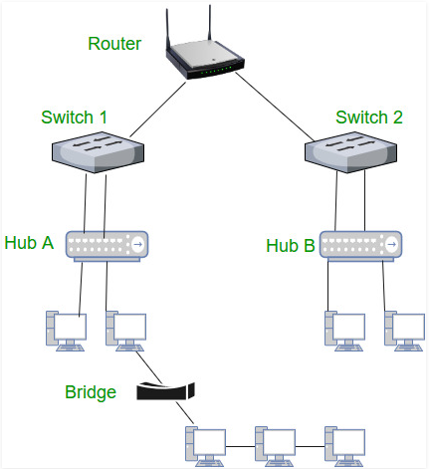
Fig: Represents interconnectivity between different network devices[2].

Slide 9
Gateway
A gateway is a passage to connect two networks together that may work upon different networking models.
Gateways are also called protocol converters and can operate at any network layer.
Gateways are generally more complex than switch or router.
Notes:
They basically work as the messenger agents that take data from one system, interpret it, and transfer it to another system.

Slide 10
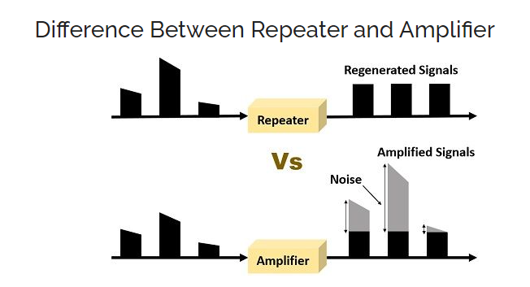

Slide 11
Router
It is a device like a switch that routes data packets based on their IP addresses.
Router is a Network Layer device.
Notes:
Routers normally connect LANs and WANs together and have a dynamically updating routing table based on which they make decisions on routing the data packets. Router divide broadcast domains of hosts connected through it.

Slide 12
Brouter
It is also known as bridging router is a device which combines features of both bridge and router.
It can work either at data link layer or at network layer.
Working as router, it is capable of routing packets across networks and working as bridge, it is capable of filtering local area network traffic.

Slide 13
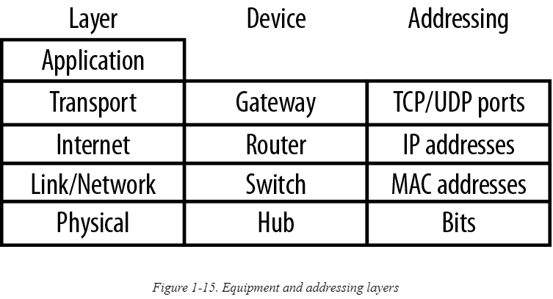
Fig: Summarizes the layer and devices at each layer[1].

Slide 14
Fig : Representing network devices & Addressing at each layer[1].

Slide 15
Content
Different Types of Network Devices
Different Types of Network Delay

Slide 16
Different Types of Network Delay
Network delay refers to the amount of time it takes for a packet to go from point A to point B.
Notes:
If Point A is the source and point B is the destination, then the delay is called an end to end delay.

Slide 17
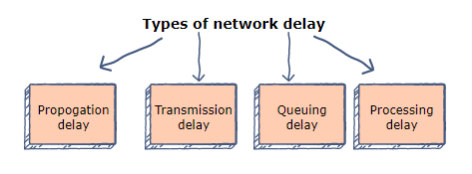
Fig: Types of Network Delay

Slide 19

Propagation delay
The time that it takes for a bit to reach from one end of a link to the other.
The delay depends on the distance (D) between the sender and the receiver, and the propagation speed (S) of the wave signal.
It is calculated as:

Slide 20

Transmission delay
Transmission delay refers to the time it takes to transmit a data packet onto the outgoing link.
The delay is determined by the size of the packet and the capacity of the outgoing link.
If a packet consists of L bits and the link has a capacity of B bits per second, then the transmission delay is equal to:

Slide 21
References
https://www.oreilly.com/library/view/packet-guide-to/9781449308094/ch01.html
https://www.geeksforgeeks.org/devices-used-in-each-layer-of-tcp-ip-model/
https://www.educative.io/edpresso/what-are-the-different-types-of-network-delay

Slide 22
Other Delays
Queuing delay
Queuing delay refers to the time that a packet waits to be processed in the buffer of a switch. The delay is dependent on the arrival rate of the incoming packets, the transmission capacity of the outgoing link, and the nature of the network’s​ traffic.
Processing delay
Processing delay is the time taken by a switch to process the packet header. The delay depends on the processing speed of the switch.

